Slide 1
Design of Engineering Experiments
– The Blocking Principle
Text Reference, Chapter 4
Blocking and nuisance factors
The randomized complete block design or the RCBD
Extension of the ANOVA to the RCBD
Other blocking scenarios…Latin square designs
Chapter 4
Design & Analysis of Experiments 8E 2012 Montgomery

Slide 2
The Blocking Principle
Blocking is a technique for dealing with nuisance factors
A nuisance factor is a factor that probably has some effect on the response, but it’s of no interest to the experimenter…however, the variability it transmits to the response needs to be minimized
Typical nuisance factors include batches of raw material, operators, pieces of test equipment, time (shifts, days, etc.), different experimental units
Many industrial experiments involve blocking (or should)
Failure to block is a common flaw in designing an experiment (consequences?)
Chapter 4
Design & Analysis of Experiments 8E 2012 Montgomery

Slide 3
The Blocking Principle
If the nuisance variable is known and controllable, we use blocking
If the nuisance factor is known and uncontrollable, sometimes we can use the analysis of covariance (see Chapter 15) to remove the effect of the nuisance factor from the analysis
If the nuisance factor is unknown and uncontrollable (a “lurking” variable), we hope that randomization balances out its impact across the experiment
Sometimes several sources of variability are combined in a block, so the block becomes an aggregate variable
Chapter 4
Design & Analysis of Experiments 8E 2012 Montgomery

Slide 4
The Hardness Testing Example
Text reference, pg 139, 140
We wish to determine whether 4 different tips produce different (mean) hardness reading on a Rockwell hardness tester
Gauge & measurement systems capability studies are frequent areas for applying DOX
Assignment of the tips to an experimental unit; that is, a test coupon
Structure of a completely randomized experiment
The test coupons are a source of nuisance variability
Alternatively, the experimenter may want to test the tips across coupons of various hardness levels
The need for blocking
Chapter 4
Design & Analysis of Experiments 8E 2012 Montgomery

Slide 5
The Hardness Testing Example
To conduct this experiment as a RCBD, assign all 4 tips to each coupon
Each coupon is called a “block”; that is, it’s a more homogenous experimental unit on which to test the tips
Variability between blocks can be large, variability within a block should be relatively small
In general, a block is a specific level of the nuisance factor
A complete replicate of the basic experiment is conducted in each block
A block represents a restriction on randomization
All runs within a block are randomized
Chapter 4
Design & Analysis of Experiments 8E 2012 Montgomery

Slide 6
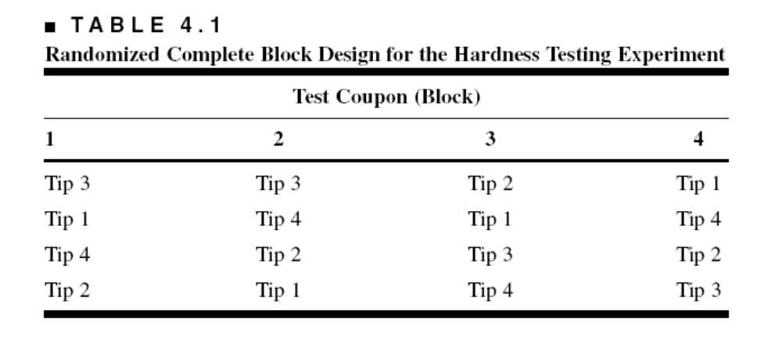
The Hardness Testing Example
Suppose that we use b = 4 blocks:
Notice the two-way structure of the experiment
Once again, we are interested in testing the equality of treatment means, but now we have to remove the variability associated with the nuisance factor (the blocks)
Chapter 4
Design & Analysis of Experiments 8E 2012 Montgomery

Slide 7
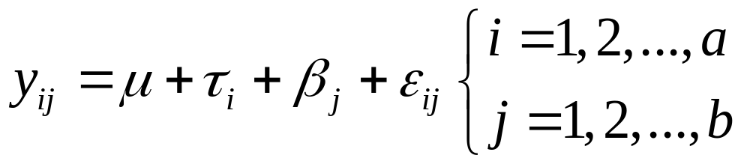
Extension of the ANOVA to the RCBD
Suppose that there are a treatments (factor levels) and b blocks
A statistical model (effects model) for the RCBD is
The relevant (fixed effects) hypotheses are
Chapter 4
Design & Analysis of Experiments 8E 2012 Montgomery

Slide 8
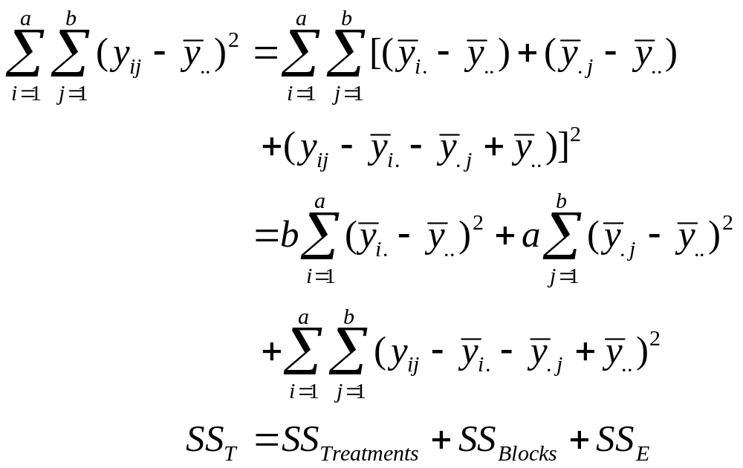
Extension of the ANOVA to the RCBD
ANOVA partitioning of total variability:
Chapter 4
Design & Analysis of Experiments 8E 2012 Montgomery

Slide 9
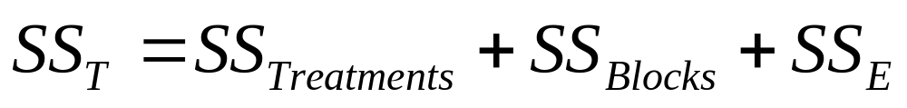
Extension of the ANOVA to the RCBD
The degrees of freedom for the sums of squares in
are as follows:
Therefore, ratios of sums of squares to their degrees of freedom result in mean squares and the ratio of the mean square for treatments to the error mean square is an F statistic that can be used to test the hypothesis of equal treatment means
Chapter 4
Design & Analysis of Experiments 8E 2012 Montgomery

Slide 10
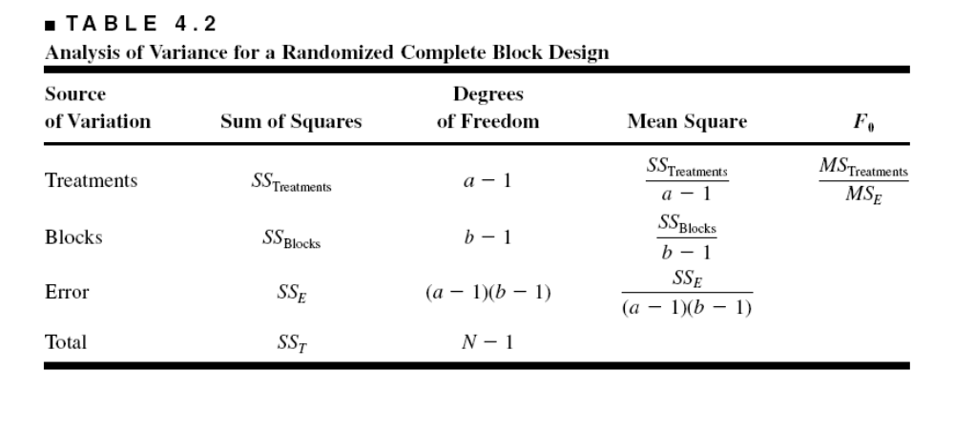
ANOVA Display for the RCBD
Manual computing (ugh!)…see Equations (4-9) – (4-12), page 144
Use software to analyze the RCBD (Design-Expert, JMP)
Chapter 4
Design & Analysis of Experiments 8E 2012 Montgomery

Slide 11
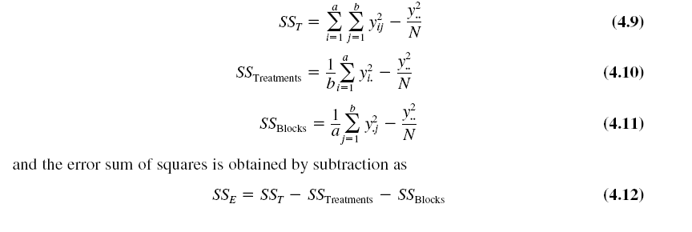
Manual computing:
Chapter 4
Design & Analysis of Experiments 8E 2012 Montgomery

Slide 12
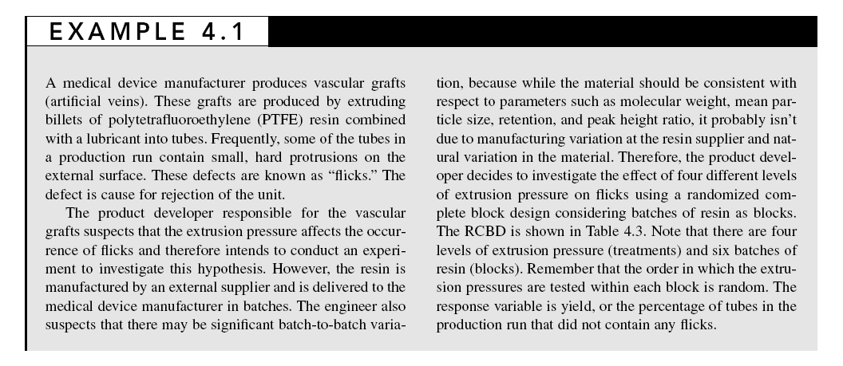
Chapter 4
Design & Analysis of Experiments 8E 2012 Montgomery

Slide 13
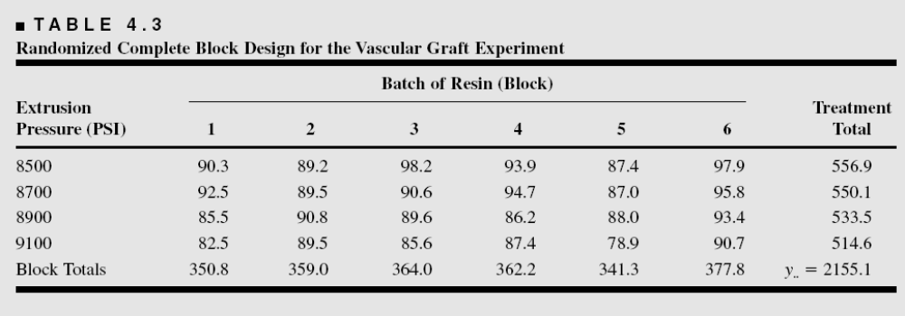
Vascular Graft Example (pg. 145)
To conduct this experiment as a RCBD, assign all 4 pressures to each of the 6 batches of resin
Each batch of resin is called a “block”; that is, it’s a more homogenous experimental unit on which to test the extrusion pressures
Chapter 4
Design & Analysis of Experiments 8E 2012 Montgomery

Slide 14
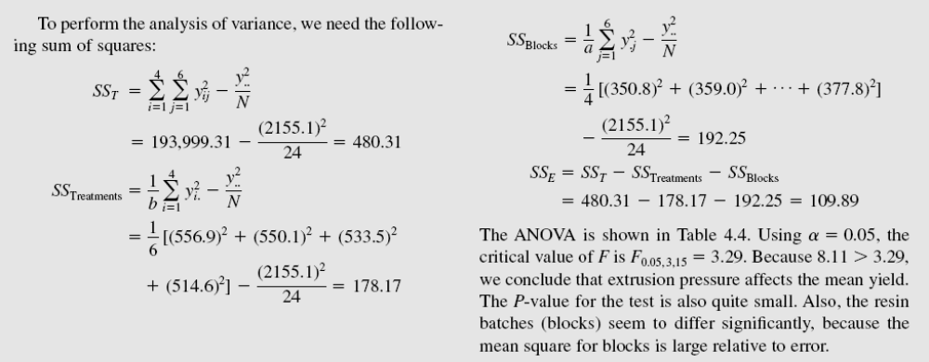
Chapter 4
Design & Analysis of Experiments 8E 2012 Montgomery

Slide 15
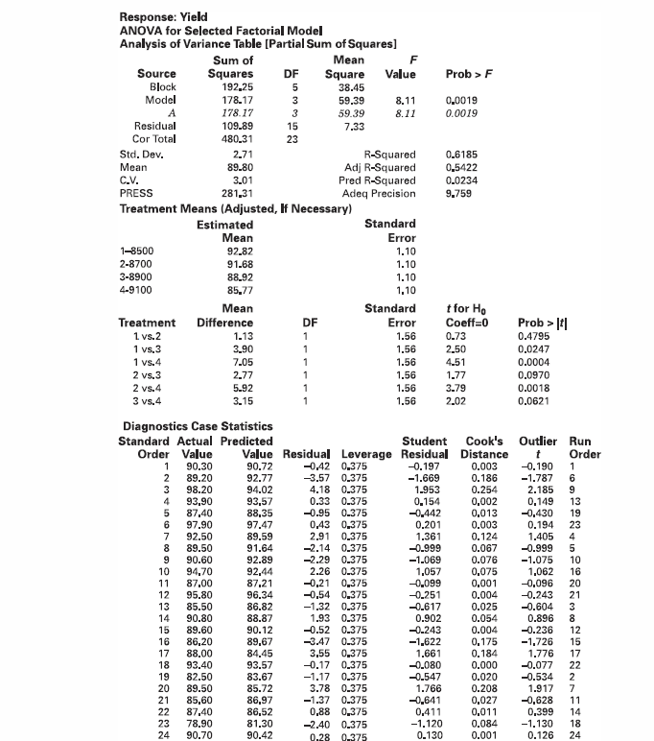
Vascular Graft Example
Design-Expert Output
Chapter 4
Design & Analysis of Experiments 8E 2012 Montgomery

Slide 16
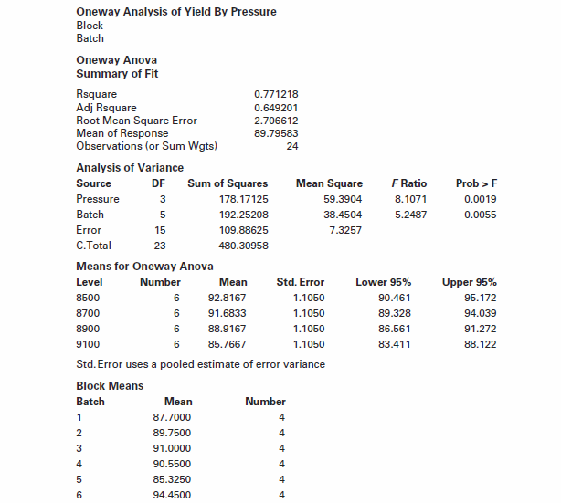
Chapter 4
Design & Analysis of Experiments 8E 2012 Montgomery

Slide 17
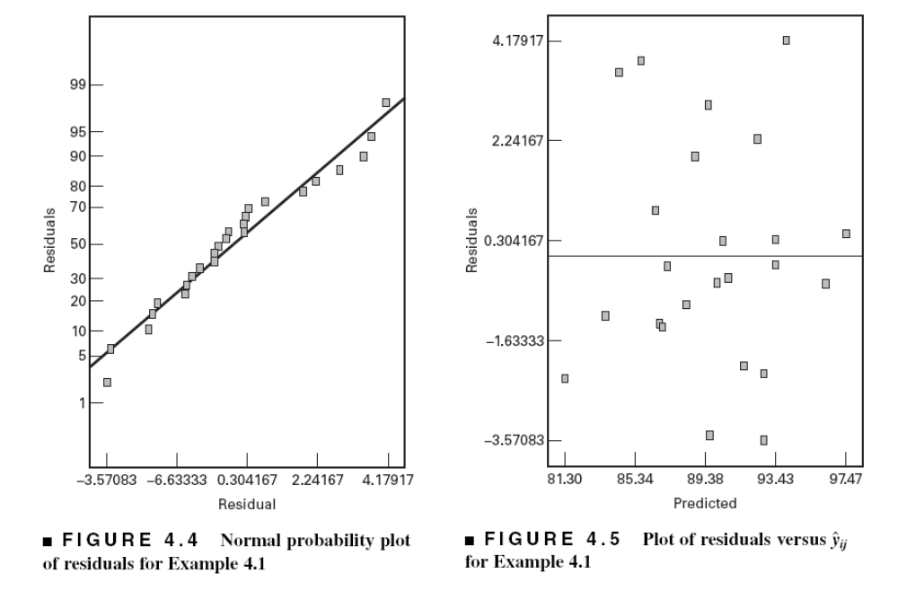
Residual Analysis for the
Vascular Graft Example
Chapter 4
Design & Analysis of Experiments 8E 2012 Montgomery

Slide 18
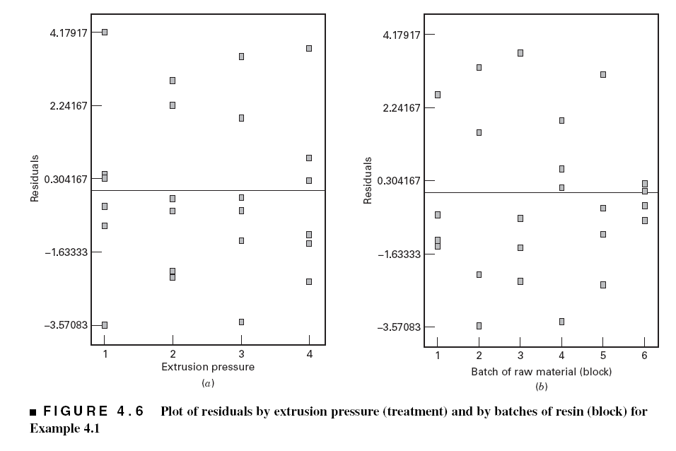
Residual Analysis for the
Vascular Graft Example
Chapter 4
Design & Analysis of Experiments 8E 2012 Montgomery

Slide 19
Residual Analysis for the
Vascular Graft Example
Basic residual plots indicate that normality, constant variance assumptions are satisfied
No obvious problems with randomization
No patterns in the residuals vs. block
Can also plot residuals versus the pressure (residuals by factor)
These plots provide more information about the constant variance assumption, possible outliers
Chapter 4
Design & Analysis of Experiments 8E 2012 Montgomery

Slide 20
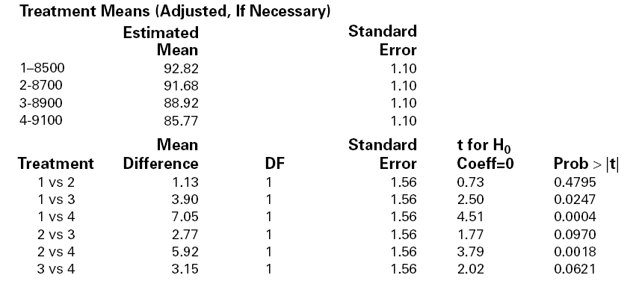
Multiple Comparisons for the Vascular Graft Example – Which Pressure is Different?
Also see Figure 4.2, Design-Expert output
Chapter 4
Design & Analysis of Experiments 8E 2012 Montgomery

Slide 21
Other Aspects of the RCBD
See Text, Section 4.1.3, pg. 132
The RCBD utilizes an additive model – no interaction between treatments and blocks
Treatments and/or blocks as random effects
Missing values
What are the consequences of not blocking if we should have?
Sample sizing in the RCBD? The OC curve approach can be used to determine the number of blocks to run..see page 133
Chapter 4
Design & Analysis of Experiments 8E 2012 Montgomery

Slide 22
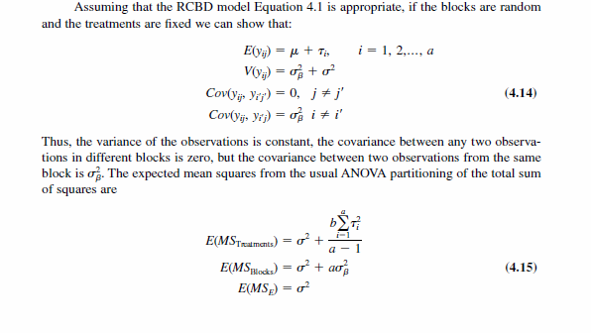
Random Blocks and/or Treatments
Chapter 4
Design & Analysis of Experiments 8E 2012 Montgomery

Slide 23
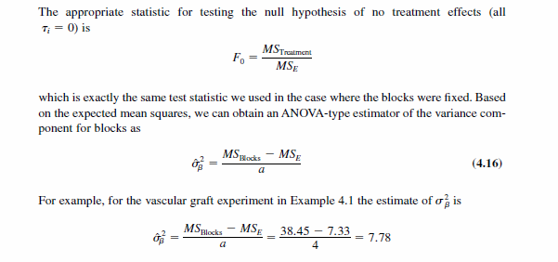
Chapter 4
Design & Analysis of Experiments 8E 2012 Montgomery

Slide 24
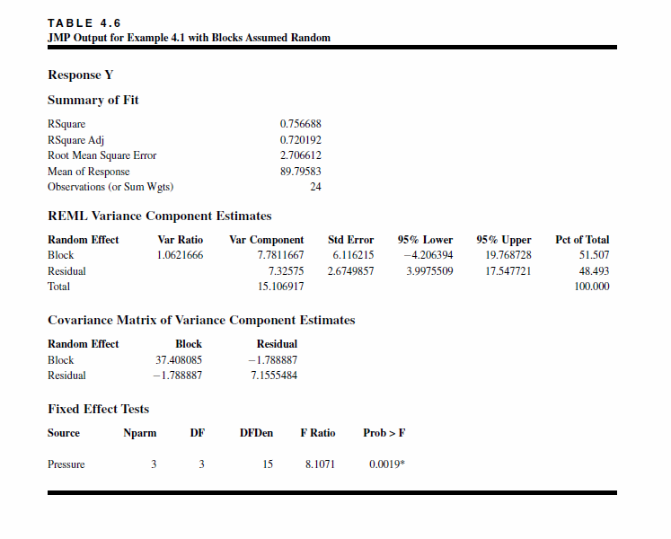
Chapter 4
Design & Analysis of Experiments 8E 2012 Montgomery

Slide 25
The Latin Square Design
Text reference, Section 4.2, pg. 158
These designs are used to simultaneously control (or eliminate) two sources of nuisance variability
A significant assumption is that the three factors (treatments, nuisance factors) do not interact
If this assumption is violated, the Latin square design will not produce valid results
Latin squares are not used as much as the RCBD in industrial experimentation
Chapter 4
Design & Analysis of Experiments 8E 2012 Montgomery

Slide 26
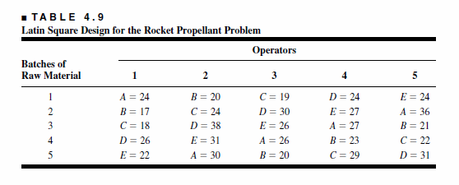

The Rocket Propellant Problem –
A Latin Square Design
This is a
Page 159 shows some other Latin squares
Table 4-13 (page 162) contains properties of Latin squares
Statistical analysis?
Chapter 4
Design & Analysis of Experiments 8E 2012 Montgomery

Slide 27
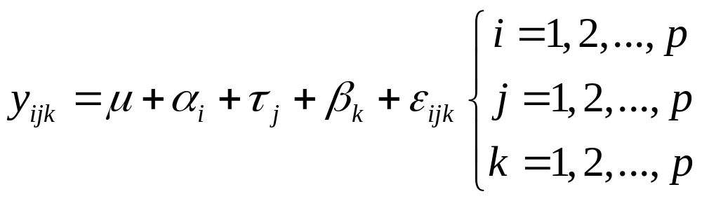
Statistical Analysis of the
Latin Square Design
The statistical (effects) model is
The statistical analysis (ANOVA) is much like the analysis for the RCBD.
See the ANOVA table, page 160 (Table 4.10)
The analysis for the rocket propellant example follows
Chapter 4
Design & Analysis of Experiments 8E 2012 Montgomery

Slide 28
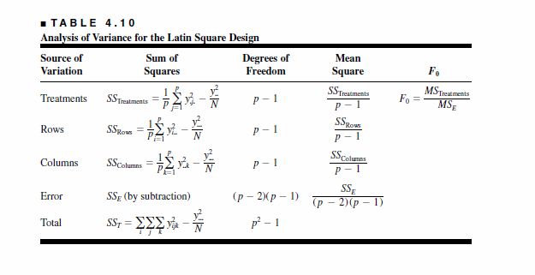
Chapter 4
Design & Analysis of Experiments 8E 2012 Montgomery

Slide 29
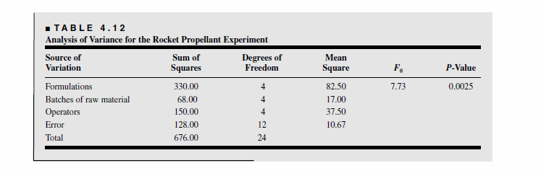
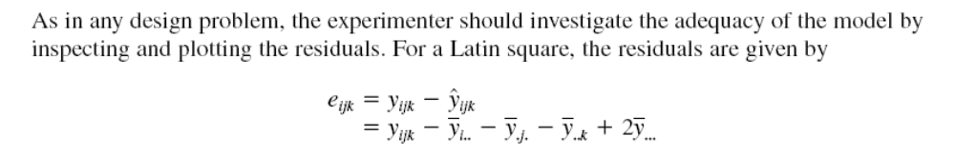
Chapter 4
Design & Analysis of Experiments 8E 2012 Montgomery

Slide 30
Other Topics
Missing values in blocked designs
  RCBD
  Latin square
Replication of Latin Squares
Crossover designs
Graeco-Latin Squares
Incomplete block designs
Chapter 4
Design & Analysis of Experiments 8E 2012 Montgomery

